Slide 1
Hardware environment
Development and debug BME280 and CCS811 sensor via I2C interface
Setup Nordic nrf52840DK develop environment and VSCode.
Debug BME280 and CCS811 source code via Arduino.
Study BME280 and CCS811 document and data sheet files.
Capture I2C raw data to debug and monitor via logic analyzer.
Development VCNL4040 sensor
Development Bluetooth
Create Bluetooth service for heart rate to transfer sensor data.
Study Bluetooth LE stack (GATT)
Modify heart rate service data format for requests.
I developed a system to control another development board for measuring the BLE (SensorEX) signals I created via Nordic software and on the mobile app LightBlue.
Development IOS APP
Create an app to capture sensor data via Bluetooth.
Development Grafana or Python application?
PC GUI

Slide 2
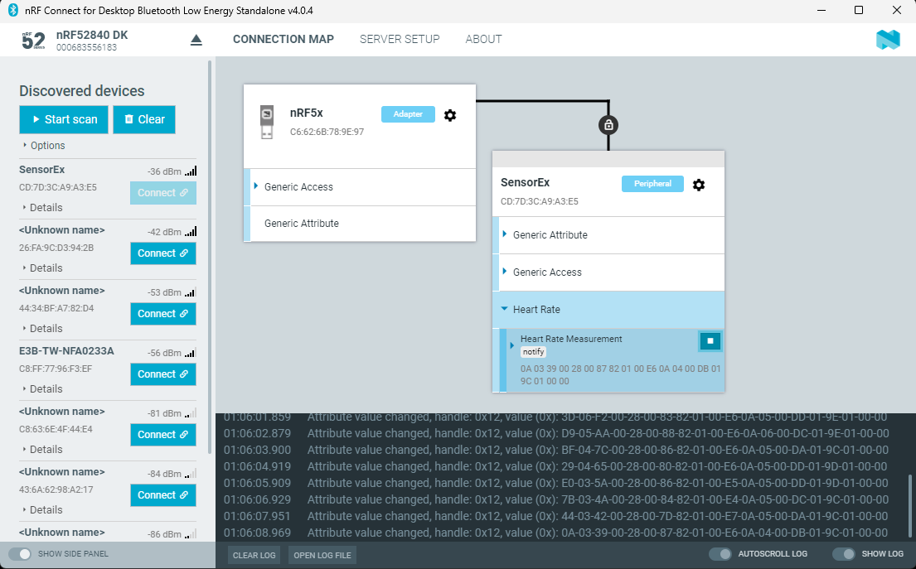
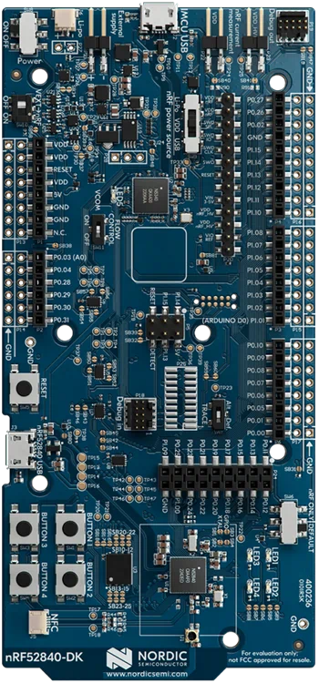
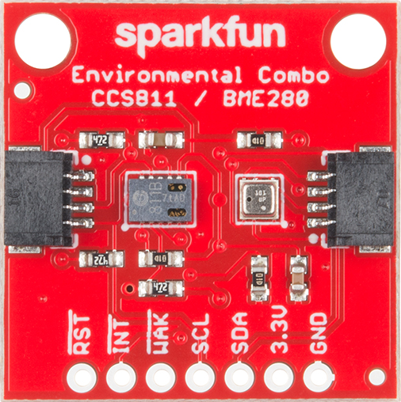
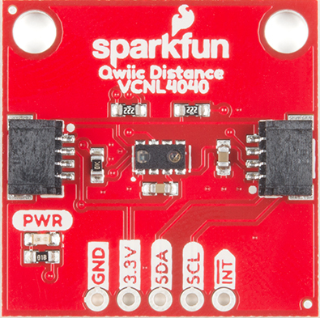
Hardware environment
PC
USB
USB
USB
LA
I2C
I2C

Slide 3
Development and debug BME280, CCS811, and VCNL4040 sensor
Reference bst-bme280-ds002.pdf, CN04-2019_attachment_CCS811_Datasheet_v1-06.pdf, and VCNL4040_Datasheet.pdf files.
Debug BME280, CCS811, and VCNL4040 source code via Arduino
Check reference doc for sample code.
Debug raw data for RW register problems via LA

Slide 4
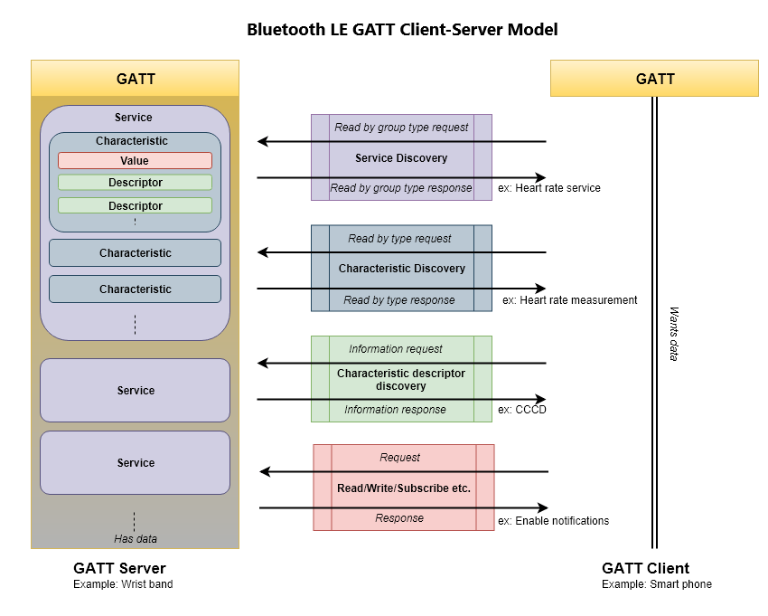
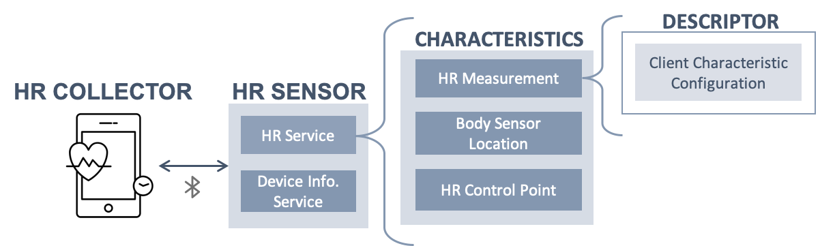
Development Bluetooth
Implement LED signal for connect or disconnect Bluetooth.
Implement a normal Bluetooth device such as battery and heart rate service.
Debug environment to confirm these service. (setup another a Bluetooth board).
Modify heart rate service transfer data to my request format.
Verify that the heart rate service (SensorEx) can be detected using the Nordic tool.
Verify that the heart rate service (SensorEx) can be detected using the LightBlue
APP on the mobile device.

Slide 5
Development IOS APP
Implement and study Swift code in XCode development environment.
Function:
Scan Bluetooth
Connect and disconnect
The capture values from the new hart rate service should be displayed individually in a tableview.
Graph and history data
Cloud?

Slide 6
Development PC GUI
…

